Slide 1

Data science topics

Slide 2
Objectives
Foundations of Big data
The effect of Big data on Digital transformation
Introduction about Hadoop
Discuss Data science Skills & Big data
Understand fundamental of Data analysis
Introduction

Slide 3
Foundations of Big Data
Ernst and Young offers the following definition: “Big Data refers to the dynamic, large and disparate volumes of data being created by people, tools, and machines. It requires new, innovative, and scalable technology to collect, host, and analytically process the vast amount of data gathered in order to derive real-time business insights that relate to consumers, risk, profit, performance, productivity management, and enhanced shareholder value.”
There are certain elements that are common across the different definitions, such as velocity, volume, variety, veracity, and value.

Slide 4
Foundations of Big Data
Velocity is the speed at which data accumulates.
Volume is the scale of the data, or the increase in the amount of data stored.
Variety is the diversity of the data.
Veracity is the quality and origin of data, and its conformity to facts and accuracy

Slide 5
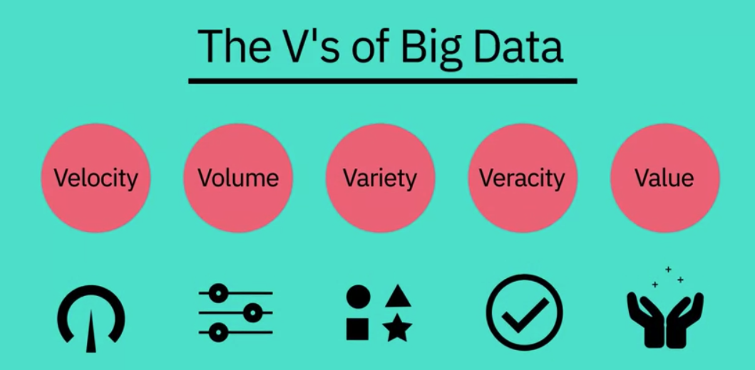
Foundations of Big Data

Slide 6
Foundations of Big Data
Example:
  Velocity: Every 60 seconds, hours of footage are uploaded to YouTube which is generating data.
  Volume: Billion people: mobile phones, desktop and laptop computers, wearable devices➔. These devices all generate, capture, and store data -- approximately 2.5 quintillion bytes every day.
  Variety: the different types of data: text, pictures, film, sound, health data from wearable devices, and many different types of data from devices connected to the Internet of Things.
  Veracity: 80% of data is unstructured and we must devise ways to produce reliable and accurate insights. The data must be categorized, analyzed, and visualized.
  Veracity: where ?

Slide 7
How Big Data is Driving Digital Transformation
Digital Transformation is an organizational and cultural change driven by Data Science, and especially Big Data.
The availability of vast amounts of data, and the competitive advantage that analyzing it brings, has triggered digital transformations throughout many industries.
Netflix moved from being a postal DVD lending system to one of the world’s foremost video streaming providers.
The Houston Rockets NBA team used data gathered by overhead cameras to analyze the most productive plays, and Lufthansa analyzed customer data to improve its service.
There is no doubt dealing with all the issues that arise in this effort requires a new mindset, but Digital Transformation is the way to succeed now and in the future.

Slide 8
What is Hadoop?
The Apache™ Hadoop® project develops open-source software for reliable, scalable, distributed computing.
The Apache Hadoop software library is a framework that allows for the distributed processing of large data sets across clusters of computers using simple programming models.
It is designed to scale up from single servers to thousands of machines, each offering local computation and storage.
Rather than rely on hardware to deliver high-availability, the library itself is designed to detect and handle failures at the application layer, so delivering a highly-available service on top of a cluster of computers, each of which may be prone to failures.
Notes:
https://hadoop.apache.org/

Slide 9
Data science Skills & Big Data
Statistical analysis and computing
Machine Learning
Deep Learning
Processing large data sets
Data Visualization
Data Wrangling
Mathematics
Programming
Statistics
Big Data

Slide 10
Data Analysis
How do you think about data analysis?

Slide 11
Data Analysis
Data analysis is the process of gleaning insights from data to inform better business decisions. The process of analyzing data typically moves through five iterative phases:
  Identify the data you want to analyze
  Collect the data
  Clean the data in preparation for analysis
  Analyze the data
  Interpret the results of the analysis
Data analysis can take different forms, depending on the question you’re trying to answer.

Slide 12
Data Analysis
A data analyst is a person whose job is to gather and interpret data in order to solve a specific problem. The role includes plenty of time spent with data but entails communicating findings too.
What skills does a data analyst need?
  Data cleaning and preparation.
  Data analysis and exploration.
  Statistical knowledge.
  Creating data visualizations.
  Creating dashboards and reports.
  Writing and communication.
  Domain knowledge.
  Problem solving.

Slide 13
Data Mining
Data mining is the process of sorting through large data sets to identify patterns and relationships that can help solve business problems through data analysis.
Data mining techniques and tools enable enterprises to predict future trends and make more-informed business decisions.
The data mining process can be broken down into these four primary stages:
  Data gathering: relevant data for an analytics application is identified and assembled.
  Data preparation: this stage includes a set of steps to get the data ready to be mined.
  Mining the data: a data scientist chooses the appropriate data mining technique and then implements one or more algorithms to do the mining.
  Data analysis and interpretation: the data mining results are used to create analytical models that can help drive decision-making and other business actions.

Slide 14
Summary
Foundations of Big data
The effect of Big data on Digital transformation
Introduction about Hadoop
Discuss Data science Skills & Big data
Understand fundamental of Data analysis
Introduction

Slide 15
Q & A

